Slide 1

Credit Risks Analysis
Hui Zhu
Siddharth Dixit
Mengyuan Wang
Notes:
Hui

Slide 2

Agenda
Background
Methodology
Conclusion
Notes:
Change the picture
Hui

Slide 3
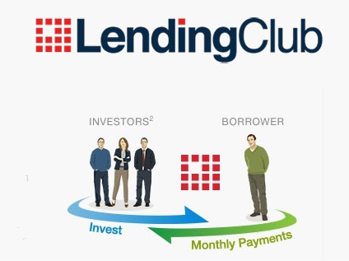
Background
Peer to peer lending company
Largest online credit marketplace
Borrowers obtain a loan
Investors purchase loan payments
Notes:
Hui

Slide 4
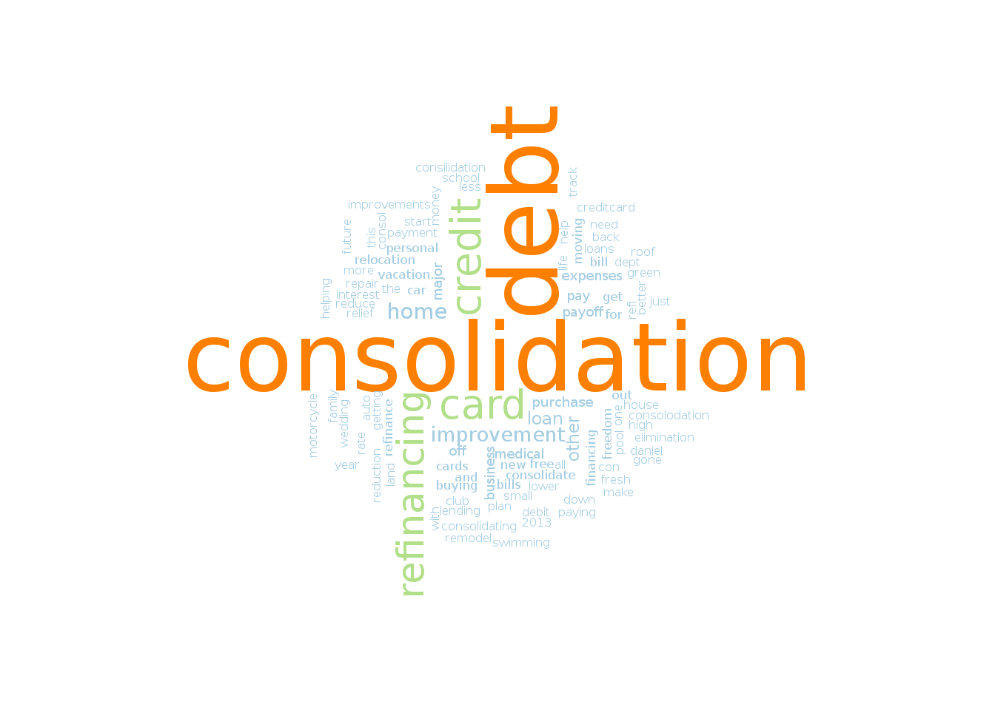
Data Set
About 50,000 observations
Selected 18 out of 75 variables
Loan Status (loan_status)
Is it fully paid or charged off?
Notes:
Find a picture
Hui
Kaggle

Slide 5
Methodology
Linear
Logistic
Feature Selection
Neutral Network
Knn
Naive Bayes
Tree
Emsemble
Kmeans
Association Rule
Notes:
Hui

Slide 6
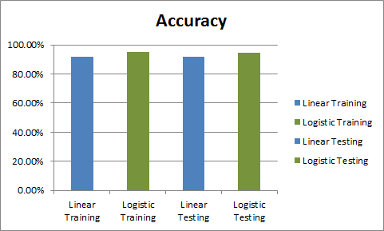
Linear/Logistic Regression
Notes:
Sid
Speaker: Hui
False negative rate is high, logistic regression is definitely better than linear. It means there is strong evidence of model being dependant on the variables chosen initially.

Slide 7
Linear/Logistic Regression
Linear Regression
Logistic Regression
prediction
prediction
 | 0 | 1
0 | 2688 | 2601
1 | 195 | 28039
Training
Accuracy:
91.7%
 | 0 | 1
0 | 4038 | 1251
1 | 395 | 27839
Training
Accuracy:
95.1%
actual
actual
prediction
prediction
 | 0 | 1
0 | 1168 | 1106
1 | 101 | 11993
Testing
Accuracy:
91.6%
 | 0 | 1
0 | 1703 | 571
1 | 201 | 11893
Testing
Accuracy:
94.6%
actual
actual
Notes:
Sid
Speaker: Hui
False positive rate is high for linear regression, but logistic takes care of it and reduced the errors significantly for positive prediction.
This is important as false positives mean the Lending Club losing a lot of money lent to the borrowers and lesser gains.

Slide 8
Best Subset Selection
“Error in leaps.exhaustive(a, really.big) :
Exhaustive search will be S L O W, must specify really.big=T
In addition: Warning message:
In leaps.setup(x, y, wt = wt, nbest = nbest, nvmax = nvmax, force.in = force.in, :6 linear dependencies found”
Lesson: Try random forest for so many (55) variables!
Notes:
Sid
Speaker: Sid
We encountered an error that we hadn’t seen before. This means that we took one too many variables and best subset selection couldn’t take place.

Slide 9
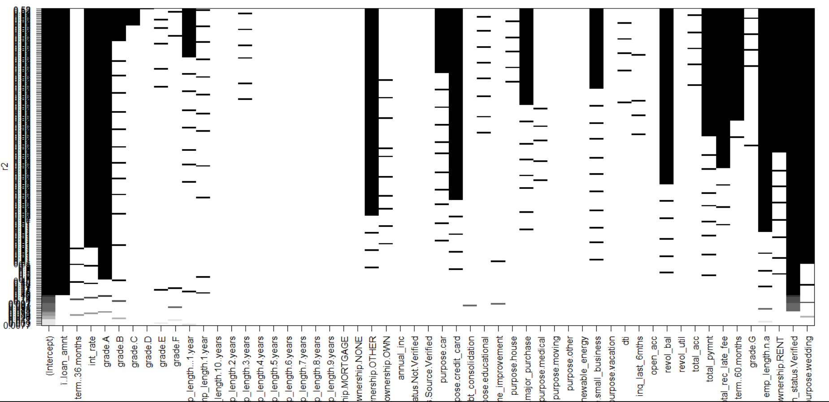
Forward Selection
(Backward is even worse!)
Notes:
Sid
Speaker: Sid
Only few basic independent variables identified like loan amount, interest rate and term of 36 months. Mostly inconclusive.

Slide 10
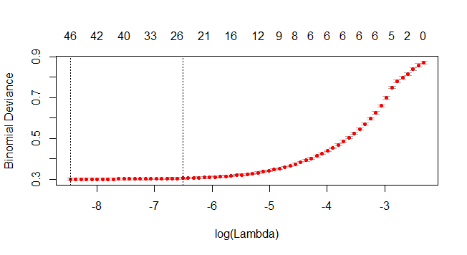
Lasso
Bestlam=0.0002117184
Notes:
Hui
Speaker: Sid
We see that the error keeps decreasing as we include more and more variables, so there’s no point of reducing the lower limit of lambda. Still, we see a plateau after best size 7.
So 7 predictors are enough to get significant accuracy.

Slide 11
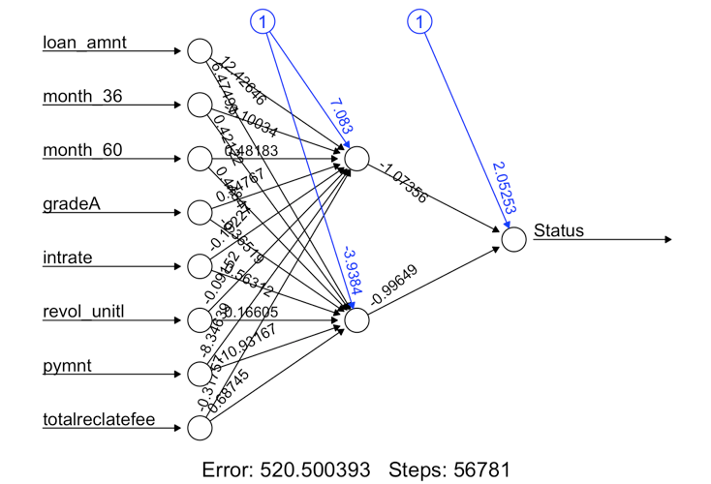
Neural Network
Training Data Set
prediction
 | 0 | 1
0 | 4301 | 988
1 | 232 | 28002
Accuracy:
96.4%
actual
Testing Data Set
prediction
 | 0 | 1
0 | 1812 | 462
1 | 116 | 11978
Accuracy:
96.0%
actual
Notes:
Speaker: Sid
Neural Network gives one of the highest accuracies and and also low error rate in both categories. It also uses only 8 independent variables data to determine the loan status. Although a lot of these 8 were ultimately converted to dummy variables so more should be taken into account for the neural network.

Slide 12
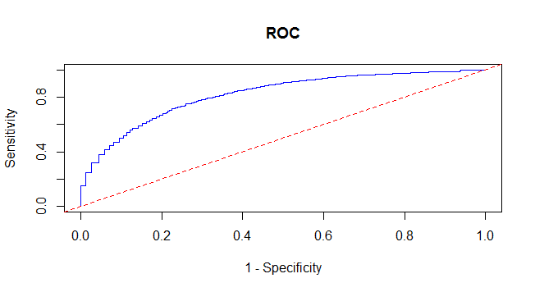
KNN & Naive Bayes
KNN
Training Data Set
Naive Bayes
prediction
Accuracy:
94.9%
 | 0 | 1
0 | 3791 | 1498
1 | 202 | 28032
actual
Testing Data Set
prediction
 | 0 | 1
0 | 693 | 1581
1 | 3785 | 8309
Accuracy:
62.7%
actual
Notes:
April
Speaker: Sid
KNN clearly seems to be overfitting as seen when it gets more errors in the testing data.
Naive bayes is also poor, because none of the predictors are completely independant. For example, loan amount is proportional to the monthly payment or loan duration.

Slide 13
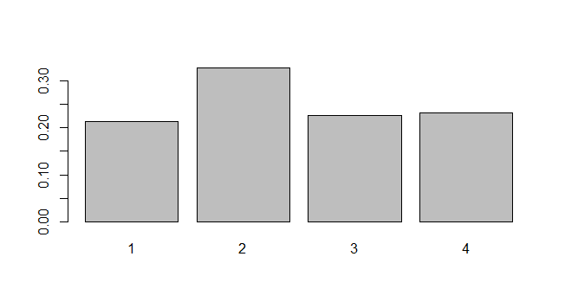
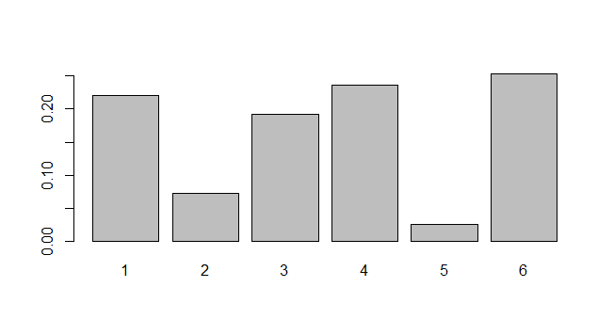
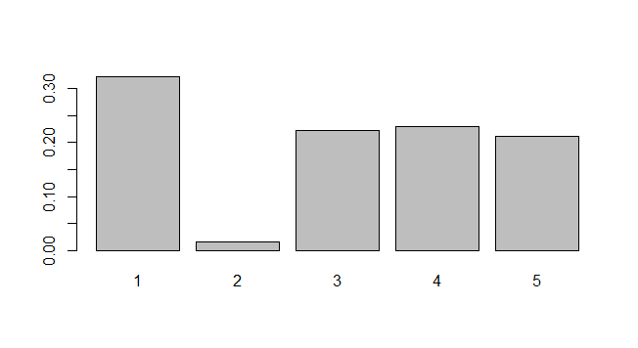
KMeans
Notes:
Hui
Speaker: Sid
K-means is valuable at k=6 because we get a cluster (1) with 40% charged off rate. This can be used to view prospective customers more closely for business value.

Slide 14
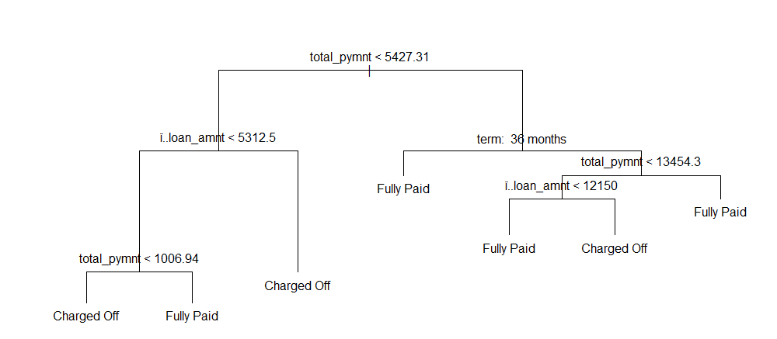
Tree
Accuracy:91.78%
Notes:
Hui
Speaker: April
Full tree: 10, High accuracy states clearer boundaries on determining charged off status. A high total payment means less likelihood of being charged off later on, so most of the risk comes at the initial part of loan repayment for lending club.

Slide 15
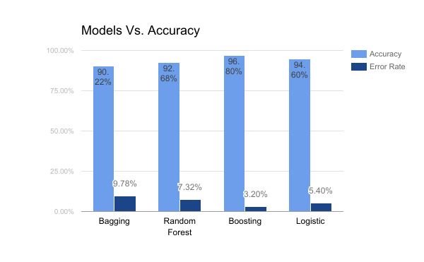
Ensembles
Notes:
Sid: Boosting has 96.8% accuracy, so it is the best predict method.
Speaker: April

Slide 16
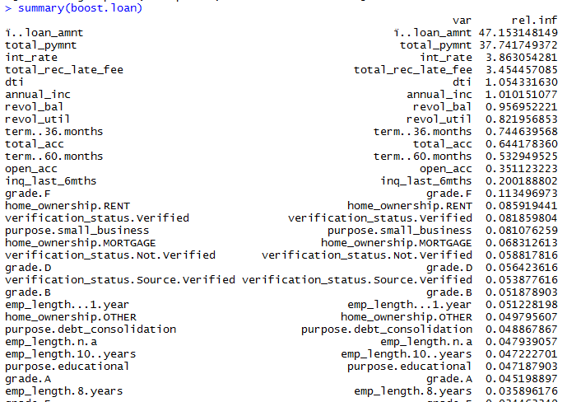
Predictors (Boosting)
High Impactors:
Loan Amount
Total Payment
Interest Rate
Late Fee Received
Notes:
Sid: We see that these variables lead to a high increase in the accuracy and their removal would mean higher error in determining the outcome.

Slide 17
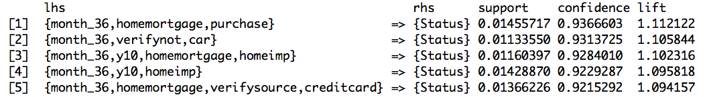
Association Rule
Top 5 association rules for Loan Status Description (support = 0.01, confidence = 0.8)
Notes:
April
Speaker: April
These rules state that for almost every loan, a duration of 36 months of returning ensures that they will be fully paid. Additionally, if someone has not mortgaged their home, it becomes a strong classifying input too.

Slide 18
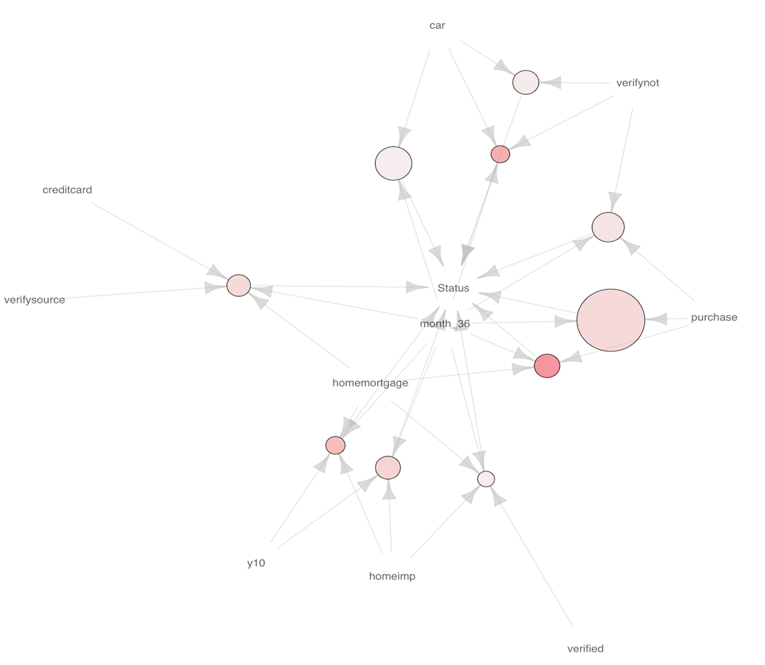
Association Rule
Notes:
April
Speaker: April

Slide 19

Conclusion
Best Model: Boosting (96.8%)
False Positives -> Predict Fully paid but Defaults -> Risk!
False Negatives -> Not given loan but can fully pay -> Potential!
Less than 2% false negative in most of the models
Business Point-> Reduce False positives
Difficulties:
Reduce the number of Variables
Forward, Backward and Lasso
Notes:
Speaker: April
Too much time to compute Forward, Backward and Lasso. It keeps picking more variables for lesser error. Boosting does not overfit even with high training accuracy and works well on test data. Reduction in false positives would mean lending club gives lesser loans to people who are less likely to repay it.

Slide 20
Questions?

